Slide 1
Mark 9 : 42-50

Slide 2
⁴² “Whoever causes one of these little ones who believe in me to sin, it would be better for him if a great millstone were hung around his neck and he were thrown into the sea. ⁴³ And if your hand causes you to sin, cut it off. It is better for you to enter life crippled than with two hands to go to hell, to the unquenchable fire. ⁴⁵ And if your foot causes you to sin, cut it off. It is better for you to enter life lame than with two feet to be thrown into hell.

Slide 3
⁴⁷ And if your eye causes you to sin, tear it out. It is better for you to enter the kingdom of God with one eye than with two eyes to be thrown into hell, ⁴⁸ ‘where their worm does not die and the fire is not quenched.’ ⁴⁹ For everyone will be salted with fire. ⁵⁰ Salt is good, but if the salt has lost its saltiness, how will you make it salty again? Have salt in yourselves, and be at peace with one another.”

Slide 4


Slide 5
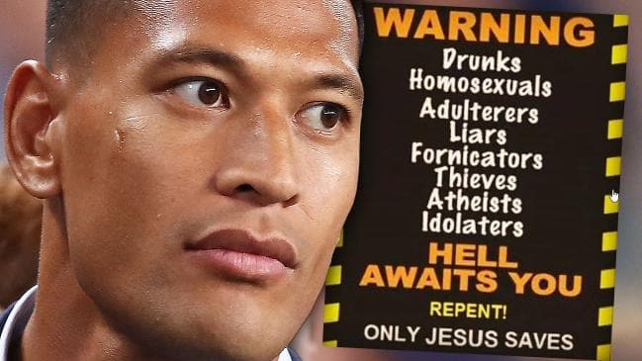
izzyfolau
Those that are living in Sin will end up in Hell unless you repent. Jesus Christ loves you and is giving you time to turn away from your sin and come to him.

Slide 6
As disciples of Jesus: What are we to think about Hell?
Jesus had more to say about “Hell” than anyone else in the Bible
Gehenna – a valley where children were sacrificed to the false God, Molech.
Became a desecrated, cursed place.
Became the smoldering rubbish dump of Jerusalem.
1. Hell is a real place and an actual destination
A place of torment for the wicked
2. Hell is eternal
forever and ever
3. The day of Judgment is coming
Only 2 outcomes for us: With Christ in Glory ; or without Christ in Hell
Hallelujah !!! (God be praised) – His righteous judgment has finally come

Slide 7
Matthew 10:²⁶ “So have no fear of them, for nothing is covered that will not be revealed, or hidden that will not be known. ²⁷ What I tell you in the dark, say in the light, and what you hear whispered, proclaim on the housetops. ²⁸ And do not fear those who kill the body but cannot kill the soul. Rather fear him who can destroy both soul and body in hell.

Slide 8
As disciples of Jesus: What are we to think about Hell?
Jesus had more to say about “Hell” than anyone else in the Bible
Gehenna – a valley where children were sacrificed to the false God, Molech.
A desecrated, cursed place. Became the smoldering rubbish dump of Jerusalem.
1. Hell is a real place and an actual destination
A place of torment for the wicked
2. Hell is eternal
forever and ever
3. The day of Judgment is coming
Only 2 outcomes for us: With Christ in Glory ; or without Christ in Hell
Hallelujah !!! (God be praised) – His righteous judgment has finally come.
Or, are we a little bit ashamed of the coming judgment???
4. It’s Godly to grieve the judgment of the wicked

Slide 9
Ezekiel 18: ²³ Have I any pleasure in the death of the wicked, declares the Lord YHWH, and not rather that he should turn from his way and live?

Slide 10
As disciples of Jesus: What are we to think about Hell?
Jesus had more to say about “Hell” than anyone else in the Bible
Gehenna – a valley where children were sacrificed to the false God, Molech.
A desecrated, cursed place. Became the smoldering rubbish dump of Jerusalem.
1. Hell is a real place and an actual destination
A place of torment for the wicked
2. Hell is eternal
forever and ever
3. The day of Judgment is coming
Only 2 outcomes for us: With Christ in Glory ; or without Christ in Hell
Hallelujah !!! (God be praised) – His righteous judgment has finally come.
Or, are we a little bit ashamed of the coming judgment???
4. It’s Godly to grieve the judgment of the wicked
Justice demands a day of judgment and the punishment of sins
5. In God’s mercy, He bore the punishment Himself
6. Those who repent of sin and believe in Jesus Christ, are forgiven

Slide 11
^{1 John 2:3} And by this we know that we have come to know him, if we keep his commandments. ⁴ Whoever says “I know him” but does not keep his commandments is a liar, and the truth is not in him, ⁵ but whoever keeps his word, in him truly the love of God is perfected. By this we may know that we are in him: ⁶ whoever says he abides in him ought to walk in the same way in which he walked.

Slide 12
As disciples of Jesus: What are we to think about Hell?
Jesus had more to say about “Hell” than anyone else in the Bible
Gehenna – a valley where children were sacrificed to the false God, Molech.
A desecrated, cursed place. Became the smoldering rubbish dump of Jerusalem.
1. Hell is a real place and an actual destination
A place of torment for the wicked
2. Hell is eternal
forever and ever
3. The day of Judgment is coming
Only 2 outcomes for us: With Christ in Glory ; or without Christ in Hell
Hallelujah !!! (God be praised) – His righteous judgment has finally come.
Or, are we a little bit ashamed of the coming judgment???
4. It’s Godly to grieve the judgment of the wicked
Justice demands a day of judgment and the punishment of sins
5. In God’s mercy, He bore the punishment Himself
6. Those who repent of sin and believe in Jesus Christ, are forgiven

Slide 13
^{John 3: 16} “For God so loved the world, that he gave his only Son, that whoever believes in him should not perish but have eternal life.
¹⁷ For God did not send his Son into the world to condemn the world, but in order that the world might be saved through him.
¹⁸ Whoever believes in him is not condemned, but whoever does not believe is condemned already, because he has not believed in the name of the only Son of God. ¹⁹ And this is the judgment: the light has come into the world, and people loved the darkness rather than the light because their works were evil. ²⁰ For everyone who does wicked things hates the light and does not come to the light, lest his works should be exposed. ²¹ But whoever does what is true comes to the light, so that it may be clearly seen that his works have been carried out in God.”

Slide 14
Hell
Jesus had more to say about “Hell” than anyone else in the Bible
Gehenna – a valley where children were sacrificed to the false God, Molech.
A desecrated, cursed place. Became the smoldering rubbish dump of Jerusalem.
1. Hell is a real place and an actual destination
A place of torment
2. Hell is eternal
forever and ever
3. The day of Judgment is coming
Only 2 outcomes for us: With Christ in Glory ; or without Christ in Hell
Hallelujah !!! (God be praised) – His righteous judgment has finally come.
Or, are we a little bit ashamed of the coming judgment???
4. It’s Godly to grieve the judgment of the wicked
Justice demands a day of judgment and the punishment of sins
5. In God’s mercy, He bore the punishment Himself
6. Those who repent of sin and believe in Jesus Christ, are forgiven
Do we love people enough to share the good news of Jesus with a world who don’t want to hear it?
Are we prepared to be persecuted to give this message in love
...but whoever does not believe is condemned already, because he has not believed in the name of the only Son of God.

